Slide 1
Work Energy and Momentum
Physics
Unit 3
Notes:
Physics Unit 3

Slide 2
This Slideshow was developed to accompany the textbook
  OpenStax Physics
    Available for free at https://openstaxcollege.org/textbooks/college-physics
  By OpenStax College and Rice University
  2013 edition
Some examples and diagrams are taken from the textbook.
Slides created by
Richard Wright, Andrews Academy
rwright@andrews.edu

Slide 3
03-01 Work and the Work-Energy Theorem
In this lesson you will…
• Explain how an object must be displaced for a force on it to do work.
• Explain how relative directions of force and displacement determine whether the work done is positive, negative, or zero.
• Explain work as a transfer of energy and net work as the work done by the net force.
• Explain and apply the work-energy theorem.

Slide 4
03-01 Work and the Work-Energy Theorem
Which of the following is NOT work?
  Pushing a Stalled Car
  Pulling a Wagon
  Climbing stairs
  Falling Down
  Carrying a Heavy Backpack Down the Hall

Slide 5
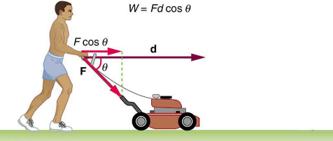

03-01 Work and the Work-Energy Theorem
Work
  Depends on the force and the distance the force moves the object.
  Want the force in the direction of the distance
$$W=\overset{⃑}{F}⋅\overset{⃑}{d}$$
$$W=Fd\cos{θ}$$
Unit: $N⋅m=J$ (Joule) (Scalar)
Watch Eureka! 08
Notes:
$$J=\frac{kg⋅m^{2}}{s^{2}}$$

Slide 6
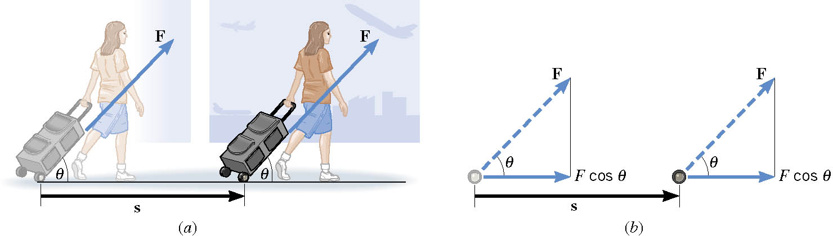
03-01 Work and the Work-Energy Theorem
Marcy pulls a backpack on wheels down the 100-m hall. The 60-N force is applied at an angle of 30° above the horizontal. How much work is done by Marcy?
W = 5200 J
Notes:
$$W=Fd\cos{θ}$$
$$W=\left(60 N\right)\left(100 m\right)\cos{30°}=5196 J$$

Slide 7

03-01 Work and the Work-Energy Theorem
Drew is carrying books (200 N) down the 100-m hall. How much work is Drew doing on the books?
W = 0 J
The force is vertical
displacement is horizontal.
Notes:
$$W=Fd\cos{θ}$$
$$W=\left(200 N\right)\left(100 m\right)\cos{90°}=0 J$$

Slide 8
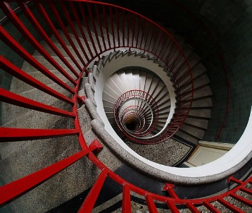
03-01 Work and the Work-Energy Theorem
You carry some books (200 N) while walking down stairs height 2 m and length 3 m. How much work do you do?
W = -400 J
Notes:
F = 200 N (lift up)
d = 2 m (down)
$$W=Fd\cos{θ}=\left(200 N\right)\left(2 m\right)\cos{180°}=−400 J$$

Slide 9
03-01 Work and the Work-Energy Theorem
A suitcase is hanging straight down from your hand as you ride an escalator. Your hand exerts a force on the suitcase, and this force does work. Which one of the following is correct?
The W is negative when you ride up and positive when you ride down
The W is positive when you ride up and negative when you ride down
The W is positive
The W is negative

Slide 10
03-01 Work and the Work-Energy Theorem
Do work means → W = Fd
    F = ma
So work by a net force gives an object some acceleration
Acceleration means the velocity changes

Slide 11

03-01 Work and the Work-Energy Theorem
$F=ma$
$Fd=mad$
$vf2=v02+2ad$ → solve for ad
    $ad=\frac{1}{2}\left(v_{f}^{2}−v_{0}^{2}\right)$
$Fd=m\frac{1}{2}\left(v_{f}^{2}−v_{0}^{2}\right)$
$W=\frac{1}{2}mv_{f}^{2}−\frac{1}{2}mv_{0}^{2}$

Slide 12

03-01 Work and the Work-Energy Theorem
Energy is the ability to do work
Kinetic Energy - Energy due to motion
  If something in motion hits an object, it will move it some distance
$KE=\frac{1}{2}mv^{2}$
  Scalar
  Unit is joule (J)
  Watch Eureka! 09

Slide 13

03-01 Work and the Work-Energy Theorem
Work Energy Theorem
Work of Net external force = change in kinetic energy
$$W=\frac{1}{2}mv_{f}^{2}−\frac{1}{2}mv_{0}^{2}$$
$$W=KE_{f}−KE_{0}$$

Slide 14
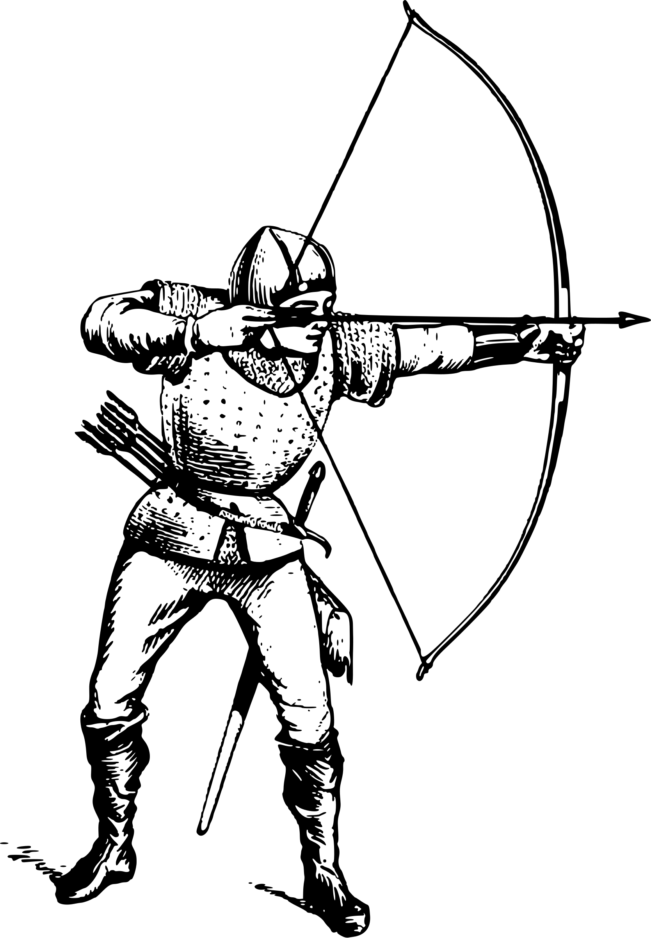
03-01 Work and the Work-Energy Theorem
A 0.075-kg arrow is fired horizontally. The bowstring exerts a force on the arrow over a distance of 0.90 m. The arrow leaves the bow at 40 m/s. What average force does the bow apply to arrow?
Notes:
$$m=0.075 kg, s=0.90 m, v_{0}=0\frac{m}{s}, v_{f}=40\frac{m}{s}$$
$$W=KE_{f}−KE_{0}$$
$$F\left(0.90 m\right)=\frac{1}{2}\left(0.075 kg\right){\left(40\frac{m}{s}\right)}^{2}−\frac{1}{2}\left(0.075 kg\right){\left(0\frac{m}{s}\right)}^{2}$$
$$F\left(0.90 m\right)=60 J$$
$$F=66.7 N$$

Slide 15

03-01 Work and the Work-Energy Theorem
Work-Energy Theorem and Spring Constants Lab
Hold a meter stick vertically on your desk.
Push a pop-up toy down so that the suction cup locks it in place. When the toy jumps up, estimate the height of the jump. Repeat 5 times.
Find the average height.
Use the height to find the final speed as in lesson 01-06 Falling Objects.
The speed you just calculated is also the speed of the toy when it jumped because projectile motion is symmetric.
What was the initial velocity of the toy before it jumped?
Find the mass of the toy.
The work-energy theorem states that $W=\frac{1}{2}mv_{f}^{2}−\frac{1}{2}mv_{0}^{2}$. Find the work the spring did on the toy.
The energy of a spring is $W=\frac{1}{2}kx^{2}$. Since the spring did the work to make the toy jump, the work from step 8 is the same as the energy in this equation. Use the work and the distance the spring was compressed to find the spring constant.
What would happen to the height the toy jumped if the spring constant were higher?
How much force did you apply to the toy to push it down? (Hint: Find the force of a spring equation from last unit.)
Notes:
4. Use $v^{2}=v_{0}^{2}+2a\left(x−x_{0}\right)$ which becomes $v^{2}=2gh$
6. 0
10. It would jump higher

Slide 16
03-01 Homework
Do lots of work.
Read 7.3, 7.4

Slide 17
03-02 Potential Energy and Conservative Forces
In this lesson you will…
• Explain gravitational potential energy in terms of work done against gravity.
• Show that the gravitational potential energy of an object of mass m at height h on Earth is given by PEg = mgh.
• Define conservative force, potential energy, and mechanical energy.
• Explain the potential energy of a spring in terms of its compression when Hooke’s law applies.
• Use the work-energy theorem to show how having only conservative forces implies conservation of mechanical energy.

Slide 18
03-02 Potential Energy and Conservative Forces
Do the lab in your worksheet.
What does this tell you about the PE and KE when objects fall?
Notes:
PE changes to KE

Slide 19

03-02 Potential Energy and Conservative Forces
Potential energy
  Energy due to position
$W=Fd$
Gravity
$W_{gravity}=mgh$
$$PE=mgh$$
Since the force of gravity is down
  We only worry about the vertical distance
Potential Energy is not absolute
  It is a difference
The path the object takes doesn’t matter, just the vertical distance
h is measured from any chosen point. Just be consistent

Slide 20


03-02 Potential Energy and Conservative Forces
Spring Potential Energy
$$PE_{S}=\frac{1}{2}kx^{2}$$
Notes:
$$W=Fd$$
$$PE_{S}=\left(average from 0 to kx by Hooke^{′}s Law\right)x$$
$$PE_{S}=\frac{1}{2}kx⋅x$$
$$PE_{S}=\frac{1}{2}kx^{2}$$

Slide 21
03-02 Potential Energy and Conservative Forces
Watch Eureka! 10
Conservative Forces
  A force where the work it does is independent of the path
    Only thing that matters is starting and stopping point

Slide 22
03-02 Potential Energy and Conservative Forces
Examples of conservative forces
  Gravitational Force
  Elastic Spring Force
  Electric Force
Examples of Nonconservative forces
  Friction
  Air resistance
  Tension
  Normal force
  Propulsion force of things like rocket engine
Each of these forces depends on the path

Slide 23

03-02 Potential Energy and Conservative Forces
Potential energy can be converted into Kinetic energy and back
Think of an object thrown up
Bottom → 0 PE, high KE
Top → high PE, 0 KE
$ΔKE=−ΔPE$
$KE_{f}−KE_{0}=−(PE_{f}−PE_{0})$
Rearrange
$\text{Conservation} \text{of} \text{Mechanical} \text{Energy}$
$$KE_{f}+PE_{f}=KE_{0}+PE_{0}$$
  if only conservative forces do net work

Slide 24
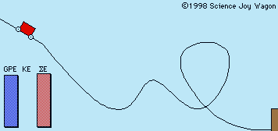
03-02 Potential Energy and Conservative Forces
If there is no work done by nonconservative forces
Total mechanical energy is constant
KE₀ + PE₀ = KE_{f} + PE_{f}

Slide 25

03-02 Potential Energy and Conservative Forces
A toy gun uses a spring to shoot plastic balls $\left(m=50 g\right)$. The spring is compressed by 3.0 cm. Let $k=2.22×{10}^{5} N/m$.
(a) Of course, you have to do some work on the gun to arm it. How much work do you have to do?
(b) Suppose you fire the gun horizontally. How fast does the ball leave the gun?
(c) Now suppose you fire the gun straight upward. How high does the ball go?
Notes:
$$a) W=Fd$$
$$W=\frac{1}{2}kx^{2}$$
$$W=\frac{1}{2}\left(2.22×{10}^{5}\frac{N}{m}\right){\left(0.03 m\right)}^{2}=99.9 J$$
$$b) KE_{f}+PE_{f}=KE_{0}+PE_{0}$$
$$\frac{1}{2}mv_{f}^{2}+\frac{1}{2}kx_{f}^{2}=\frac{1}{2}mv_{0}^{2}+\frac{1}{2}kx_{0}^{2}$$
$$\frac{1}{2}\left(0.050 kg\right)v_{f}^{2}+0=0+\frac{1}{2}\left(2.22×{10}^{5}\frac{N}{m}\right){\left(0.03 m\right)}^{2}$$
$$0.025 kg v_{f}^{2}=99.9 J$$
$$v_{f}^{2}=3996\frac{m^{2}}{s^{2}}$$
$$v_{f}=63.2\frac{m}{s}$$
$$c) KE_{f}+PE_{Gf}+{PE}_{Sf}=KE_{0}+PE_{G0}+PE_{S0}$$
At end of barrel
$$\frac{1}{2}mv_{f}^{2}+mgh_{f}+0=0+0+\frac{1}{2}kx_{0}^{2}$$
$$\frac{1}{2}\left(0.050 kg\right)v_{f}^{2}+\left(0.050 kg\right)\left(9.80\frac{m}{s^{2}}\right)\left(0.03 m\right)=\frac{1}{2}\left(2.22×{10}^{5}\frac{N}{m}\right){\left(0.03 m\right)}^{2}$$
$$0.025 kg v_{f}^{2}+0.0147 J=99.9 J$$
$$0.025 kg v_{f}^{2}=99.8853 J$$
$$v_{f}^{2}=3995.412\frac{m^{2}}{s^{2}}$$
$$v_{f}=63.2\frac{m}{s}$$
At top of path
$$KE_{f}+PE_{Gf}=KE_{0}+PE_{G0}$$
$$\frac{1}{2}mv_{f}^{2}+mgh_{f}=\frac{1}{2}mv_{0}^{2}+mgh_{0}$$
$$0+\left(0.050 kg\right)\left(9.80\frac{m}{s^{2}}\right)h_{f}=\frac{1}{2}\left(0.050 kg\right){\left(63.2\frac{m}{s}\right)}^{2}+0$$
$$\left(0.49 kg⋅\frac{m}{s^{2}}\right)h_{f}=99.9 J$$
$$h_{f}=204 m$$

Slide 26
03-02 Potential Energy and Conservative Forces
A 1500-kg car is driven off a 50-m cliff during a movie stunt. If it was going 20 m/s as it went off the cliff, how fast is it going as it hits the ground?
Notes:
$$PE_{0}+KE_{0}=PE_{f}+KE_{f}$$
$$mgh_{0}+\frac{1}{2}mv_{0}^{2}=mgh_{f}+\frac{1}{2}{mv}_{f}^{2}$$
$$\left(1500 kg\right)\left(9.8\frac{m}{s^{2}}\right)\left(50 m\right)+\frac{1}{2}\left(1500 kg\right){\left(20\frac{m}{s}\right)}^{2}=0+\frac{1}{2}\left(1500 kg\right)v_{f}^{2}$$
$$v_{f}=37.1 m/s$$

Slide 27
03-02 Homework
You have great potential…
Read 7.5, 7.6

Slide 28
03-03 Nonconservative Forces and Conservation of Energy
In this lesson you will…
• Define nonconservative forces and explain how they affect mechanical energy.
• Show how the principle of conservation of energy can be applied by treating the conservative forces in terms of their potential energies and any nonconservative forces in terms of the work they do.
• Explain the law of the conservation of energy.
• Describe some of the many forms of energy.
• Define efficiency of an energy conversion process as the fraction left as useful energy or work, rather than being transformed, for example, into thermal energy.

Slide 29

03-03 Nonconservative Forces and Conservation of Energy
Often both conservative and nonconservative forces act on an object at once.
We can write Work done by net external force as
    $W=W_{c}+W_{nc}$
    $W_{c}=−ΔPE, W=ΔKE$
    $W_{nc}=ΔKE+ΔPE$
    $KE_{0}+PE_{0}+W_{nc}=KE_{f}+PE_{f}$
    $E_{0}+W_{nc}=E_{f}$

Slide 30
03-03 Nonconservative Forces and Conservation of Energy
Law of Conservation of Energy
  The total energy is constant in any process. It may change form or be transferred from one system to another, but the total remains the same
Energy is transformed from one form to another
  Box sliding down incline
    PE transformed to KE
    KE transformed to Heat and Sound
  Engine
    Chemical to KE and Heat

Slide 31

03-03 Nonconservative Forces and Conservation of Energy
Efficiency
  Useful energy output is always less than energy input
    Some energy lost to heat, etc.
  $$Efficiency \left(Eff\right)=\frac{\text{useful} \text{energy} \text{or} \text{work} \text{output}}{\text{total} \text{energy} \text{input}}=\frac{W_{out}}{E_{in}}$$

Slide 32

03-03 Nonconservative Forces and Conservation of Energy
A rocket starts on the ground at rest. Its final speed is 500 m/s and height is 5000 m. If the mass of the rocket stays approximately 200 kg. Find the work done by the rocket engine.
W = 3.48 x 10⁷ J
Notes:
$$E_{0}+W_{nc}=E_{f}$$
$$\frac{1}{2}mv_{0}^{2}+mgh_{0}+W_{nc}=\frac{1}{2}mv_{f}^{2}+mgh_{f}$$
$$\frac{1}{2}\left(200 kg\right){\left(0\right)}^{2}+\left(200 kg\right)\left(9.8\frac{m}{s^{2}}\right)\left(0\right)+W_{nc}=\frac{1}{2}\left(200 kg\right){\left(500\frac{m}{s}\right)}^{2}+\left(200 kg\right)\left(9.8\frac{m}{s^{2}}\right)\left(5000 m\right)$$
$$W_{nc}=2.50×{10}^{7} J+9.80×{10}^{6} J$$
$$W_{nc}=3.48×{10}^{7} J$$

Slide 33
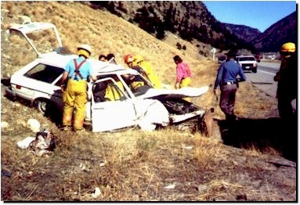
03-03 Nonconservative Forces and Conservation of Energy
A 1500-kg car’s brakes failed and it coasts down a hill from rest. The hill is 10 m high and the car has a speed of 12 m/s at the bottom of the hill. How much work did friction do on the car?
W_{f} = -39000 J
Notes:
$$E_{0}+W_{nc}=E_{f}$$
$$\frac{1}{2}mv_{0}^{2}+mgh_{0}+W_{nc}=\frac{1}{2}mv_{f}^{2}+mgh_{f}$$
$$0+\left(1500 kg\right)\left(9.8\frac{m}{s^{2}}\right)\left(10 m\right)+W_{nc}=\frac{1}{2}\left(1500 kg\right){\left(12\frac{m}{s}\right)}^{2}+0$$
$$W_{nc}=−39000 J$$

Slide 34
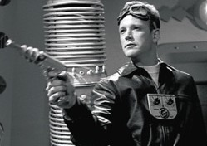
03-03 Nonconservative Forces and Conservation of Energy
Captain Proton’s rocket pack provides 800,000 J of work to propel him from resting on his ship which is near the earth to 50 m above it. Captain Proton’s mass is 90 kg. What is his final velocity?
V = 130 m/s
Notes:
$$E_{0}+W_{nc}=E_{f}$$
$$\frac{1}{2}mv_{0}^{2}+mgh_{0}+W_{nc}=\frac{1}{2}mv_{f}^{2}+mgh_{f}$$
$$0+0+800000 J=\frac{1}{2}\left(90 kg\right)v_{f}^{2}+\left(90 kg\right)\left(9.8\frac{m}{s^{2}}\right)\left(50 m\right)$$
$$129.6\frac{m}{s}=v_{f}$$

Slide 35
03-03 Homework
Energy is not to be conserved while you do this homework
Read 7.7

Slide 36
03-04 Power
In this lesson you will…
• Calculate power by calculating changes in energy over time.
• Examine power consumption and calculations of the cost of energy consumed.

Slide 37
03-04 Power
Two cars with the same mass do the same amount of work to get to 100 km/h.
Which car is better
    Takes 8.0 s
    Takes 6.2 s
Sometimes the time taken to do the work is important

Slide 38

03-04 Power
Rate that work is done
$$P=\frac{W}{t}$$
Unit: joule/s = watt (W)
Notes:
Unit named after James Watt who invented the steam engine
In the American system, horsepower is often used
One horsepower is moving 550 pounds 1 foot in 1 second

Slide 39
03-04 Power
Since work changes the amount of energy in an object
Power is the rate that energy is changing
Notes:
Power in the human body would be how quickly calories are being burned
Look at the table on page 166 to compare the power with the activity

Slide 40
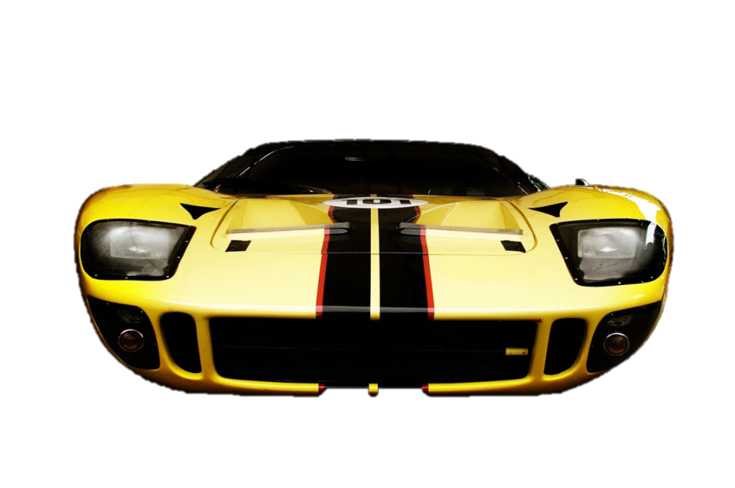
03-04 Power
A 1000 kg car accelerates from 0 to 100 km/h in 3.2 s on a level road. Find the average power of the car.
P = 121000 W
    162 horsepower
Notes:
v₀ = 0
v_{f} = 100 km/h = 27.78 m/s
t = 3.2 s
m = 500 kg
$$P=\frac{W}{t}$$
$$P=\frac{\frac{1}{2}mv_{f}^{2}−\frac{1}{2}mv_{0}^{2}}{t}$$
$$P=\frac{\frac{1}{2}\left(1000 kg\right){\left(27.78\frac{m}{s}\right)}^{2}−0}{3.2 s}=121000 W$$

Slide 41
03-04 Power
Electrical Energy
  Often measured in kWh because Pt = W
If it costs $0.10 per kWh, how much will it cost to run a 1000 W microwave for 2 minutes?
Notes:
$$P=1000 W=1 kW, t=2 min=\frac{1}{30}h$$
$$P=\frac{W}{t}$$
$$1 kW=\frac{W}{\frac{1}{30} h}$$
$$W=\frac{1}{30} kWh$$
$$cost=\frac{1}{30}kWh\left(\$0.10\right)=\$0.0033$$

Slide 42
03-04 Power
Power of Pushups Lab
Choose a group member to do pushups. They need to know their weight. Convert their weight to mass in kg.
A person lifts approximately 65% of their mass when doing a pushup. How much mass will your group member be lifting?
Measure the height of their shoulders at the lowest part of a pushup.
Measure the height of their shoulders at the highest part of a pushup.
What distance do the shoulders move during a pushup (just going up)?
How much work is done for one pushup?
How much work is done for 10 pushups?
Time how long it takes your group member to do 10 pushups.
Calculate the power of doing 10 pushups by your group member.
Compare your result with other groups.

Slide 43
03-04 Homework
Power through these problems in no time.
Read 7.8, 7.9

Slide 44
03-05 Energy in Humans and the World
In this lesson you will…
• Explain the human body’s consumption of energy when at rest vs. when engaged in activities that do useful work.
• Calculate the conversion of chemical energy in food into useful work.
• Describe the distinction between renewable and nonrenewable energy sources.
• Explain why the inevitable conversion of energy to less useful forms makes it necessary to conserve energy resources.

Slide 45
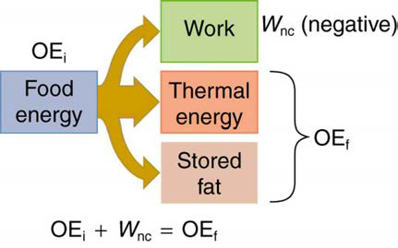
03-05 Energy in Humans and the World
Human bodies (all living bodies) convert energy
Rate of food energy use is metabolic rate
Basal metabolic rate (BMR)
  Total energy conversion at rest
  Highest: liver and spleen
  See table 7.4
Table 7.5 shows energy consumed for various activites

Slide 46
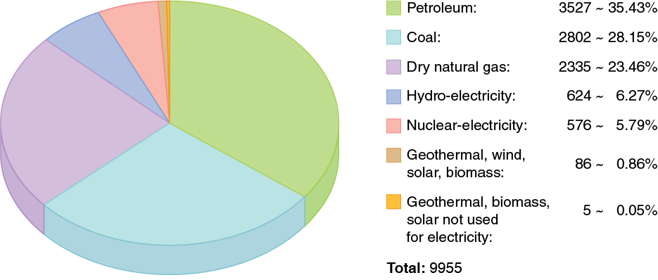
03-05 Energy in Humans and the World
Energy is required to do work
World wide, the most common source of energy is oil
Notes:
From 2008 units are billions of kWh

Slide 47
03-05 Energy in Humans and the World
USA has 4.5% of world population, but uses 24% of world’s oil
World energy consumption continues to increase quickly
  Growing economies in China and India
  Fossil Fuels are very polluting
  Many countries trying to develop renewable energy like wind and solar
Generally, higher energy use per capita = better standard of living

Slide 48
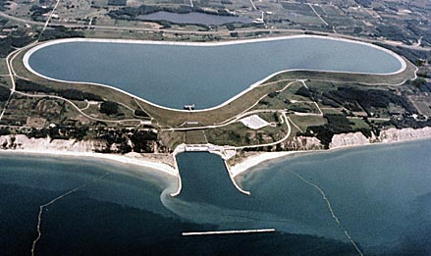
03-05 Energy in Humans and the World
Ludington Pumped Storage Power Plant
It consists of a reservoir 110 feet (34 m) deep, 2.5 miles (4.0 km) long, and one mile (1.6 km) wide which holds 27 billion US gallons (100 Gl) of water. The 1.3-square-mile (3.4 km2) reservoir is located on the banks of Lake Michigan.
The power plant consists of six reversible turbines that can each generate 312 megawatts of electricity for a total output of 1,872 megawatts.
At night, during low demand for electricity, the turbines run in reverse to pump water 363 feet (111 m) uphill from Lake Michigan into the reservoir.
During periods of peak demand water is released to generate power. Electrical generation can begin within two minutes with peak electric output of 1872 MW achieved in under 30 minutes. Maximum water flow is over 33 million US gallons (120,000 m³) per minute.
This process was designed to level the load of nearby nuclear power plants on the grid. It also replaces the need to build natural gas peak power plants used only during high demand.

Slide 49
03-05 Homework
You have the power to change to world, but will you work to do it?
Read 8.1, 8.2

Slide 50
03-06 Impulse and Momentum
In this lesson you will…
• Define linear momentum.
• Explain the relationship between momentum and force.
• Calculate momentum given mass and velocity.
• Define impulse.
• Describe effects of impulses in everyday life.
• Determine the average effective force using graphical representation.
• Calculate average force and impulse given mass, velocity, and time.

Slide 51
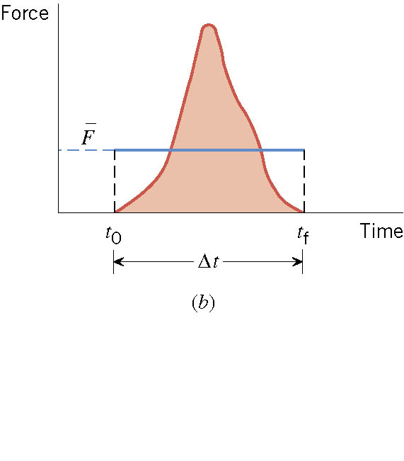
03-06 Impulse and Momentum
Often the force acting on an object is not constant.
  Baseball or Tennis ball being hit
Times of force often short
Force can be huge

Slide 52
03-06 Impulse and Momentum
To hit a ball well
  Both size of force and time of contact are important
  Bring both these together in concept of impulse

Slide 53

03-06 Impulse and Momentum
Impulse
$$J=Ft$$
Unit: Ns
Is a vector

Slide 54
03-06 Impulse and Momentum
Object responds to amount of impulse
Large impulse → Large response → higher v_{f}
Large mass → less velocity
Both mass and velocity play role in how responds to impulse

Slide 55

03-06 Impulse and Momentum
Linear Momentum
$$p=mv$$
Unit: kg m/s
Is a vector
Is important when talking about collisions

Slide 56

03-06 Impulse and Momentum
$$F=ma$$
$$a=\frac{v_{f}−v_{0}}{Δt}$$
$$F=m\frac{v_{f}−v_{0}}{Δt}=\frac{mv_{f}−mv_{0}}{Δt}$$
$$FΔt=mv_{f}−mv_{0}$$

Slide 57
03-06 Impulse and Momentum
Impulse = Change in Momentum
Hard to measure force during contact
Find change in momentum
  Use impulse-Momentum Theorem and time of contact to find average force of contact
Watch NASCAR Crash

Slide 58
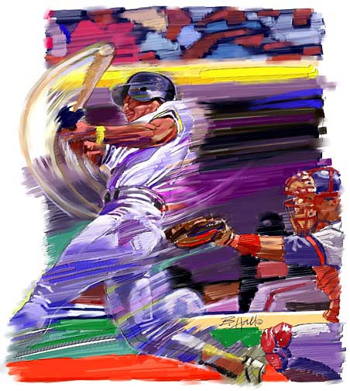
03-06 Impulse and Momentum
A baseball (m = 0.14 kg) with initial velocity of -40 m/s (90 mph) is hit. It leaves the bat with a velocity of 60 m/s after 0.001 s. What is the impulse and average net force applied to the ball by the bat?
Impulse = 14 Ns
F = 14000 N
Notes:
$$FΔt=mv_{f}−mv_{0}$$
$$FΔt=\left(0.14 kg\right)\left(60\frac{m}{s}\right)−\left(0.14kg\right)\left(−40\frac{m}{s}\right)=14 kg m/s$$
$$F=\frac{14 kg\frac{m}{s}}{0.001 s}=14000 N$$

Slide 59
03-06 Impulse and Momentum
A raindrop (m = .001 kg) hits a roof of a car at -15 m/s. After it hits, it spatters so the effective final velocity is 0. The time of impact is .01 s. What is the average force?
  F = 1.5 N
What if it is ice so that it bounces off at 10 m/s?
  F = 2.5 N
Watch Offset Crash
Notes:
$$Ft=mv_{f}−mv_{0}$$
$$F\left(0.01 s\right)=\left(0.001 kg\right)0−\left(0.001 kg\right)\left(−15\frac{m}{s}\right)$$
$$F\left(0.01 s\right)=0.015 kg\frac{m}{s}$$
$$F=1.5 N$$
$$F\left(0.01 s\right)=\left(0.001 kg\right)\left(10\frac{m}{s}\right)−\left(0.001 kg\right)\left(−15\frac{m}{s}\right)$$
$$F\left(0.01 s\right)=0.025 kg\frac{m}{s}$$
$$F=2.5 N$$
Hailstones are usually more massive than raindrops so that the force is even greater.
The rebounding adds force to the collision

Slide 60
03-06 Homework
Keep up your momentum on these problems
Read 8.3

Slide 61
03-07 Conservation of Momentum
In this lesson you will…
• Describe the principle of conservation of momentum.
• Derive an expression for the conservation of momentum.
• Explain conservation of momentum with examples.

Slide 62
03-06b Bumper Testing Lab
Each team makes a bumper out of paper and tape.
  2.5 cm × 4 cm × 10 cm
  Do not use excessive tape
The bumper is placed against the end of the track.
The cart is released from a distance as set by the teacher.
The maximum force is read from the sensor.

Slide 63
03-07 Conservation of Momentum
Do the lab in your worksheet.
Explain why if a person standing of frictionless ice shoots a bullet at 200 m/s does not move backwards are 200 m/s.
A 100 kg person pushes off from a 50 kg person on frictionless ice. If the 100 kg person moves at 3 m/s, what speed will the 50 kg person move at?
Notes:
The person has more mass than the bullet.
Since they are half the mass, they will move at twice the speed. Mass and speed ratios are reciprocals.

Slide 64
03-07 Conservation of Momentum
System
  All the objects involved in the problem
  Usually only two objects
Internal Forces – Forces that the objects exert on each other
External Forces – Forces exerted by things outside of the system
Notes:
Usually only two objects for linear momentum because very rarely do more than two object hit at the same time. It usually happens that two hit, and then one of those hits another.
Internal forces → the objects pushing each other
External forces → gravity pulling the objects down

Slide 65
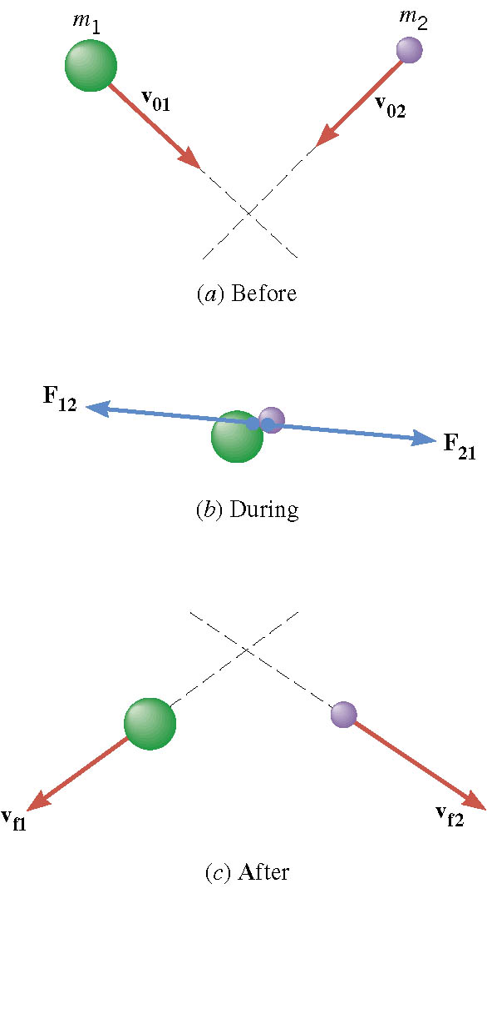
03-07 Conservation of Momentum
Two balls hit in the air
During the collision
  Internal Forces = F₁₂ and F₂₁
  External Forces = Weight (W₁ and W₂)
Notes:
F₁₂ and F₂₁ are action-reaction pair from Newton’s Third Law are equal and opposite

Slide 66

03-07 Conservation of Momentum
$FΔt=mv_{f}−mv_{0}$
Object 1: $\left(W_{1}+F_{12}\right)Δt=m_{1}v_{f1}−m_{1}v_{01}$
Object 2: $\left(W_{2}+F_{21}\right)Δt=m_{2}v_{f2}−m_{2}v_{02}$
Add
$\left(W_{1}+W_{2}+F_{12}+F_{21}\right)Δt=\left(m_{1}v_{f1}+m_{2}v_{f2}\right)−\left(m_{1}v_{01}+m_{2}v_{02}\right)$
$\left(Ext F+Int F\right)Δt=p_{f}−p_{0}$

Slide 67

03-07 Conservation of Momentum
Since F₁₂ and F₂₁ are equal and opposite
  Sum of internal forces = 0
$\left(External Forces\right)Δt=p_{f}−p_{0}$
If Isolated system:
$0=p_{f}−p_{0}$ OR $p_{0}=p_{f}$
Notes:
Isolated system = no external forces

Slide 68

03-07 Conservation of Momentum
Law of Conservation of Momentum
  In an isolated system the total momentum remains constant
$$p_{0}=p_{f}$$
  System can contain any number of objects
Watch Crash Video

Slide 69
03-07 Conservation of Momentum
Reasoning Strategy
Decide on the system
Identify internal and external forces
Is the system isolated? If no, then can’t use conservation of momentum
Set the total initial momentum of the isolated system equal to the total final momentum

Slide 70
03-07 Conservation of Momentum
Two billiard balls are colliding on a table. In order to apply the law of conservation of momentum, what should the system be? One ball or both billiard balls?
  Two billiard balls.
External Forces: Weight and Normal Force
  If the table is horizontal these cancel
If it were one ball, then the force of the second ball hitting it would not cancel with anything.

Slide 71
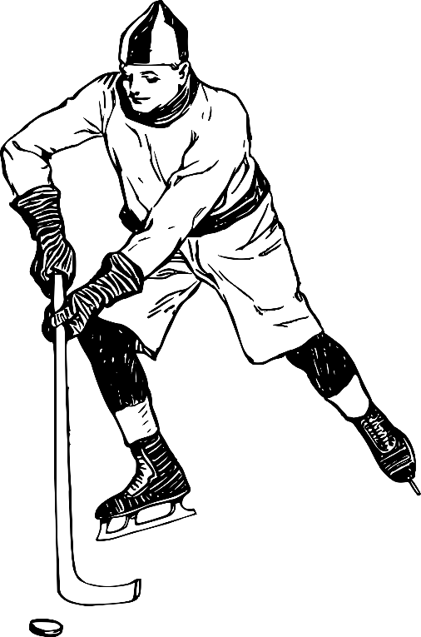
03-07 Conservation of Momentum
A hockey puck of mass 0.17 kg and velocity 5 m/s is caught by a .5 kg mitten laying on the ice. What is the combined velocity after the puck is in the mitten? (ignore friction)
v = 1.27 m/s
Notes:
$$p_{0}=p_{f}$$
$$m_{1}v_{01}+m_{2}v_{02}=m_{1}v_{f1}+m_{2}v_{f2}$$
$$\left(0.17 kg\right)\left(5 \frac{m}{s}\right)+\left(0.5 kg\right)\left(0\frac{m}{s}\right)=\left(0.17 kg\right)v+\left(0.5 kg\right)v$$
$$0.85 kg\frac{m}{s}=\left(0.67 kg\right)v$$
$$v=1.27 m/s$$

Slide 72
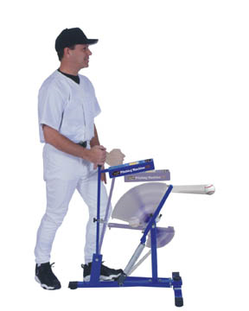
03-07 Conservation of Momentum
A 5 kg baseball pitching machine is placed on some frictionless ice. It shoots a 0.15 kg baseball horizontally at 35 m/s. How fast is the pitching machine moving after it shoots the ball?
-1.05 m/s
This is why you feel recoil
when you shoot a gun
Notes:
$$p_{0}=p_{f}$$
$$m_{1}v_{01}+m_{2}v_{02}=m_{1}v_{f1}+m_{2}v_{f2}$$
$$\left(5 kg\right)\left(0\right)+\left(0.15 kg\right)\left(0\right)=\left(5 kg\right)v+(0.15kg)(35 m/s)$$
$$0=\left(5 kg\right)v+5.25 kg m/s$$
$$−(5 kg)v=−5.25 kg m/s$$
$$v=1.05 m/s$$

Slide 73
03-07 Homework
Solving problems is fun!
Read 8.4, 8.5

Slide 74
03-08 Elastic and Inelastic Collisions
In this lesson you will…
• Describe an elastic collision of two objects in one dimension.
• Determine the final velocities in an elastic collision given masses and initial velocities.
• Define inelastic collision.
• Explain perfectly inelastic collision.

Slide 75
03-08 Elastic and Inelastic Collisions
Newton’s Cradle Lab
Lay the ruler perfectly horizontal and put the marbles in the center touching each other.
From one end, roll a marble so that it hits the other four. What happens?
From one end, roll two marbles so that it hits the other three. What happens?
From one end, roll three marbles so that it hits the other two. What happens?
From one end, roll four marbles so that it hits the other one. What happens?
Roll one marble extra fast to try to get two marbles to come out at half the speed.
If a marble of mass m comes in at velocity v and stops and an identical marble flies out the other side, what will its velocity have to be to conserve momentum?
Show that momentum was conserved in steps 3-7.
Show that momentum would be conserved in step 7, but kinetic energy would not be conserved if two marbles came out at half the speed.
Notes:
4. One flies out
5. Two fly out
6. Three fly out
7. Four fly out
8. Can’t
9. v
10. mv is the same before and after
11. mv is the same before and after, but $KE=\frac{1}{2}mv^{2}$ will not be the same because of the v²
$$KE=KE$$
$$\frac{1}{2}m{\left(2v\right)}^{2}=\frac{1}{2}mv^{2}+\frac{1}{2}mv^{2}$$
$$2mv^{2}≠mv^{2}$$

Slide 76
03-08 Elastic and Inelastic Collisions
Watch Bumper Video
Watch Truck Crash video
Subatomic – kinetic energy often conserved
Macroscopic – kinetic energy usually not conserved
  Converted into heat
  Converted into distortion or damage
Notes:
Demo energy lost to heat by smashing two steel balls together

Slide 77
03-08 Elastic and Inelastic Collisions
Elastic – kinetic energy conserved
Inelastic – kinetic energy not conserved
Completely inelastic – the objects stick together
Notes:
SUV crash test video
NASCAR video
Crash test humor

Slide 78
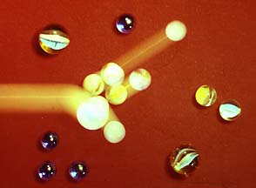
03-08 Elastic and Inelastic Collisions
You are playing marbles. Your .10 kg shooter traveling at 1 m/s hits a stationary .05 kg cat’s eye marble. If it is an elastic collision what are the velocities after the collision?
v_{c} = 1.33 m/s
v_{s} = .333 m/s
Notes:
Momentum
$$m_{s}v_{0s}+m_{c}v_{0c}=m_{s}v_{fs}+m_{c}v_{fc}$$
$$\left(0.1 kg\right)\left(1\frac{m}{s}\right)+\left(0.05 kg\right)\left(0\right)=\left(0.1 kg\right)v_{fs}+\left(0.05 kg\right)v_{fc}$$
$$0.1 kg\frac{m}{s}=\left(0.1 kg\right)v_{fs}+\left(0.05 kg\right)v_{fc}$$
$$v_{fs}=1 m/s−0.5 v_{fc}$$
Kinetic Energy
$$\frac{1}{2}m_{s}v_{0s}^{2}+\frac{1}{2}m_{c}v_{0c}^{2}=\frac{1}{2}m_{s}v_{fs}^{2}+\frac{1}{2}m_{c}v_{fc}^{2}$$
$$\frac{1}{2}\left(0.1 kg\right){\left(1\frac{m}{s}\right)}^{2}+0=\frac{1}{2}\left(0.1 kg\right)v_{fs}^{2}+\frac{1}{2}\left(0.05 kg\right)v_{fc}^{2}$$
$$0.05 J=\left(0.05 kg\right)v_{fs}^{2}+\left(0.025 kg\right)v_{fc}^{2}$$
$$v_{fs}^{2}+0.5 v_{fc}^{2}=1 {\left(\frac{m}{s}\right)}^{2}$$
$${\left(1\frac{m}{s}−0.5v_{fc}\right)}^{2}+0.5 v_{fc}^{2}=1 {\left(\frac{m}{s}\right)}^{2}$$
$$1 {\left(\frac{m}{s}\right)}^{2}−\left(1\frac{m}{s}\right)v_{fc}+0.25 v_{fc}^{2}+0.5 v_{fc}^{2}=1 {\left(\frac{m}{s}\right)}^{2}$$
$$−\left(1\frac{m}{s}\right)v_{fc}+0.75 v_{fc}^{2}=0$$
$$v_{fc}\left(−1\frac{m}{s}+0.75 v_{fc}\right)=0$$
$$v_{fc}=0 or 1.33 m/s$$
$$v_{fs}=1\frac{m}{s}−0.5 v_{fc}$$
$$V_{fs}=1 m/s−0.5(1.33 m/s)=0.333 m/s$$

Slide 79
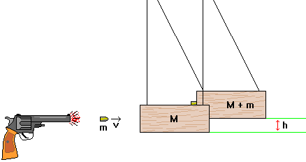
03-08 Elastic and Inelastic Collisions
A ballistic pendulum can be used to determine the muzzle velocity of a gun. A .01 kg bullet is fired into a 3 kg block of wood. The block is attached with a thin .5m wire and swings to an angle of 40°. How fast was the bullet traveling when it left the gun?
v = 455 m/s
Notes:
Do an actual demonstration
Collision
$$m_{b}v_{0b}+m_{w}v_{0w}=m_{b}v_{fb}+m_{w}v_{fw}$$
$$\left(0.01 kg\right)v_{0b}+0=\left(0.01 kg\right)v_{f}+\left(3 kg\right)v_{f}$$
$$\left(0.01 kg\right)v_{0b}=\left(3.01 kg\right)v_{f}$$
After collision
$$h=0.5 m−0.5 m\cos{40°}=0.1170 m$$
$$PE_{0}+KE_{0}=PE_{f}+KE_{f}$$
$$0+\frac{1}{2}\left(3.01 kg\right)v_{f}^{2}=\left(3.01 kg\right)\left(9.8\frac{m}{s^{2}}\right)(0.1170 m)+0$$
$$1.505 kg v_{f}^{2}=3.45 J$$
$$v_{f}=1.51 m/s$$
Combine
$$\left(0.01 kg\right)v_{0b}=\left(3.01 kg\right)\left(1.51\frac{m}{s}\right)$$
$$v_{0b}=455 m/s$$

Slide 80
03-08 Elastic and Inelastic Collisions
Watch Child Seat video
Watch Reducing Risk video

Slide 81
03-08 Homework
Bounce through these problems and let the concepts stick to you.

